Slide 1
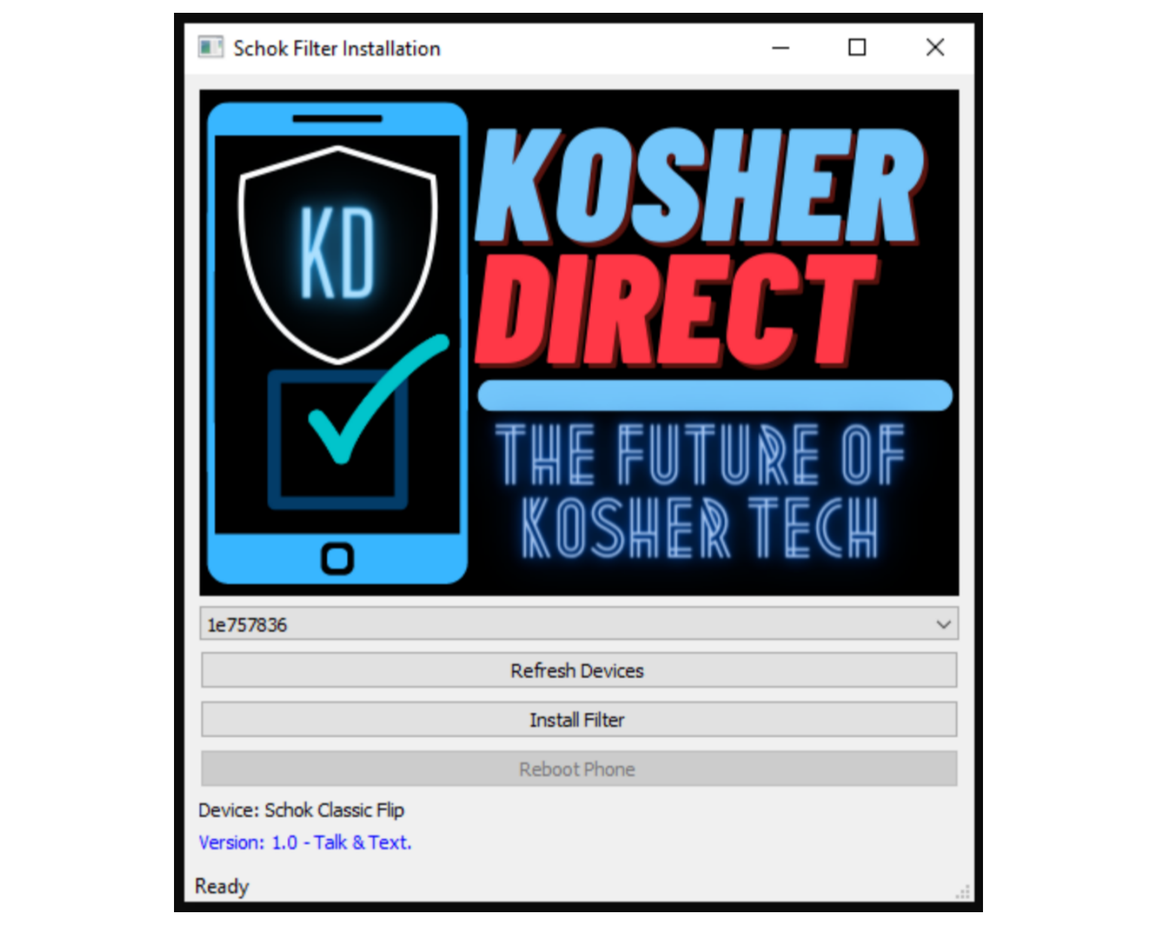
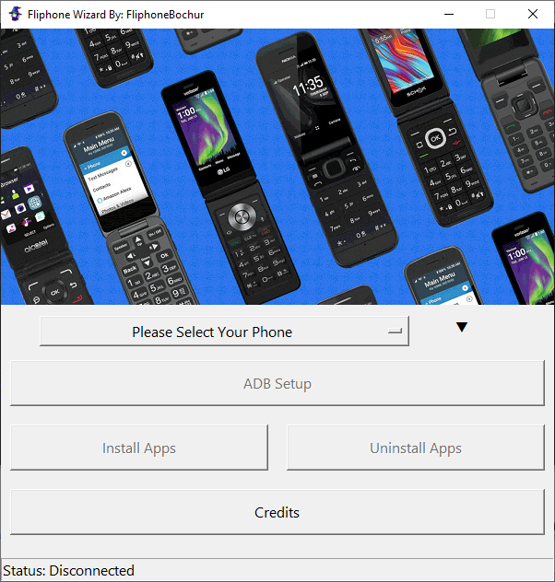
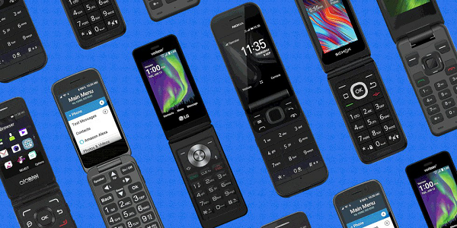
Please Select Your Phone
How to Setup ADB
Install Apps
Uninstalling Apps
SCRCPY
Credits
Status: Connected

